Slide 1








Sentiment Analysis of Lockdown in USA During Covid-19 A Case Study on Twitter using ML
Company Name: Varcons technologies
Name: Akash Tatti USN: 1HK20IS007
7TH Semester, A Section, ISE Dept
Internal Guide: Prof. Sharavana K

Slide 2


Contents
About the Company
Vision & Mission
Goal
Internship Objectives
Internship Structure
Projects Assigned
Work Done
Internship Outcomes
Certificate of INTERNSHIP

Slide 3





About the Company
We are a Technology Organization providing solutions for all web design and development, Researching and Publishing Papers to ensure the quality of most used ML Models, MYSQL, PYTHON Programming, HTML, CSS, ASP.NET and LINQ. Meeting the ever-increasing automation requirements, Varcons Technologies specialize in ERP, Connectivity, SEO Services, Conference Management, effective web promotion and tailor-made software products, designing solutions best suiting clients requirements. The organization where they have a right mix of professionals as a stakeholders to help us serve our clients with best of our capability and with at par industry standards

Slide 4




VISION & MISSION
A vis ion to em po wer a nd up skill the yo uth of the fu tu re wit h ab solut e re quisite s an d st ance to se i ze b et te r e m plo yme nt opportunities .
our me nt e es wit h wit h t he
A mis sion to e ndow
skills mar ke t ready.
in com pl i anc e r equ i re m ents
eme rging i ndu s t r y
to b ecome

Slide 5


GOAL
Varcons technologies, was incorporated with a goal, To provide high quality and optimal Technological Solutions to business requirements of our clients”. Every business is a different and has a unique business model and so are the technological requirements. They understand this and hence the solutions provided to these requirements are different as well.
Varcons is a Technology Organization providing solutions for all web design and development, MYSQL, PYTHON Programming, HTML, CSS, ASP.NET and LINQ. Meeting the ever-increasing automation requirements, Sarvamoola Software Services. specialize in ERP, Connectivity, SEO Services, Conference Management, effective webpromotion and tailormade software products, designing solutions best suiting clients requirements.

Slide 6

Internship Objectives
The Covid-19 pandemic and subsequent lockdowns in the USA have triggered a multitude of emotional responses and opinions among the population. There is a need for an advanced sentiment analysis system that can accurately capture and analyze sentiment trends in Twitter data during different phases of the lockdown, enabling a deeper understanding of the factors influencing public sentiment.
Build a Python application that utilizes natural language processing (NLP) techniques to determine the sentiment of a given keyword. The application will take user input for a keyword, analyze its sentiment using an open-source dataset, and provide feedback on whether the keyword is associated with positive, negative, or neutral sentiments

Slide 7

Internship Structure
Month 1 [Training] |  |  |  | Month 2 [Projects]
Week 1 | Week 2 | Week 3 | Week 4
What is AI? Demand for AI Classifications of AI Applications of AI Introduction to Python | Introduction to Machine Learning Some basic terms in ML Algorithms in Classification | What is Deep Learning? Fuzzy Logic Install Python and Libraries | Loading the datasets Summarizing the datasets Visualising the datasets Making some predictions | Major Project

Slide 8

Projects Assigned
Project [Major Project]
Build a python application that asks for a keyword, and you need to identify the sentiment of that keyword using an open-source dataset.
src: https://colab.research.google.com/drive/1oPzpvhw_EjbrnZhFCWnb0xu_zWWkPdZ8

Slide 9

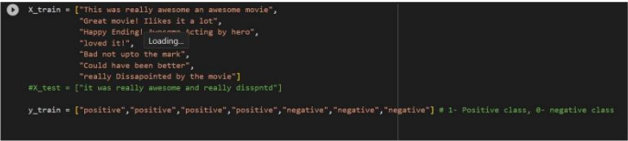
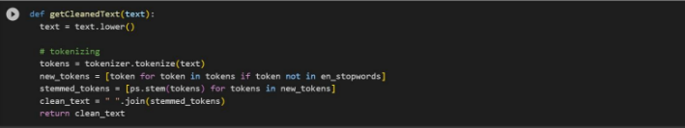
Work Done in Major Project
# Load dataset
# Load libraries

Slide 10
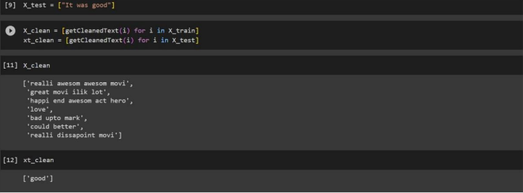
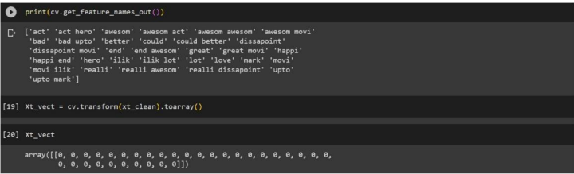
Work Done in Major Project [Iris Flower]
# Clean Data
# Vectorize Data

Slide 11
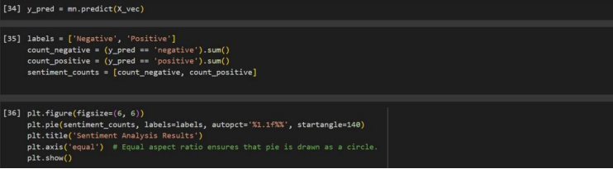
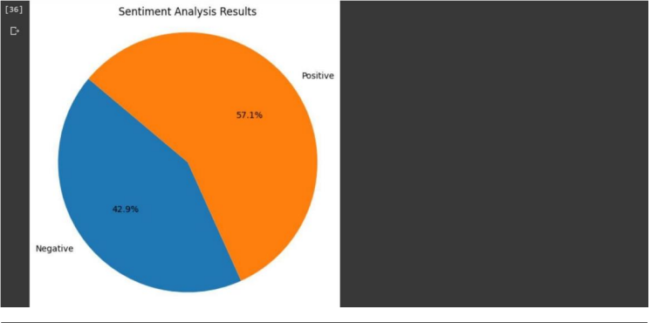
Work Done in Major Project [Iris Flower]
# Plotting the Sentiment Data

Slide 12
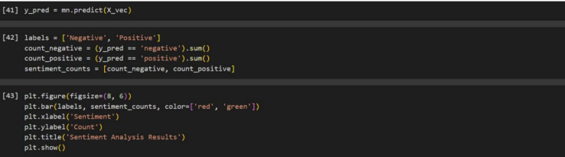
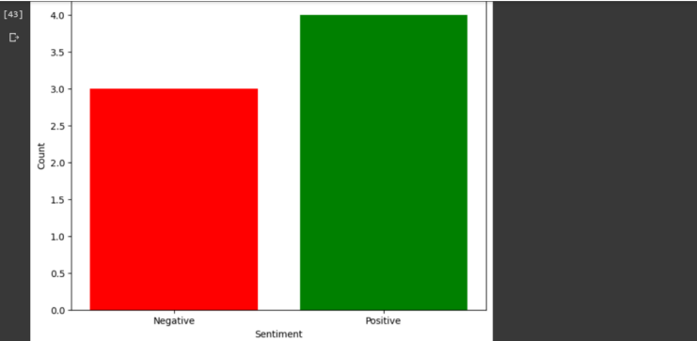
Work Done in Major Project [Iris Flower]
# Visualizing Data Set

Slide 13
Internship Outcomes
Know and get a basic overview of how a basic machine learning model is trained, tested, and used
Get familiar with the basic ML terms like classes, test data, train data, accuracy, training model
Know how to use teachable machines for basic ML projects and make simple models that can be exported/downloaded/copied and used in your apps, websites, and more.
Have a general template of classification problem that you can use on for various datasets
To code and make your own classification model
Understanding the hands-on implementation of AI and ML concepts theoretically learned.

Slide 14
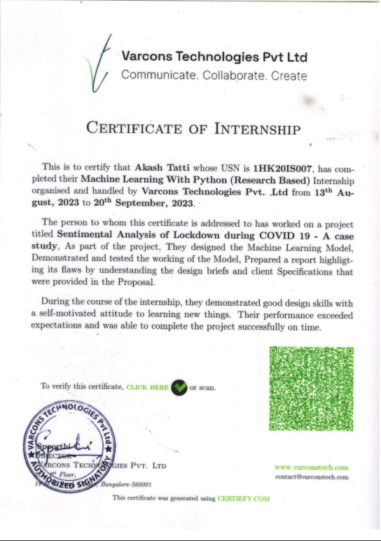

Certificate of Internship

Slide 15


Thank You
AKASH TATTI (1HK20IS007)

